Slide 1
Composite/compound area
Subtraction and addition of shapes

Slide 2
Finding the area of simple shapes is okay, but sometimes we need to find the areas of complex shapes. These are sometimes called compound or composite shapes.
eg

Slide 3
This is because they are made from adding simpler shapes together to form a composite.
eg

Slide 4
However they aren’t always just made by adding shapes together

Slide 5
They can also be made by subtracting 1 shape from another.

Slide 6
Sometimes it can be both addition and subtraction.
c

Slide 7
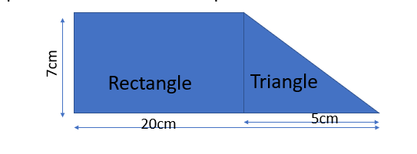
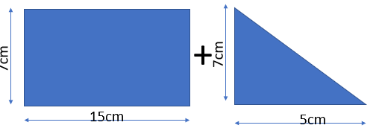
24
7
30
Area
Date
EQ – How we can use formulas to find areas of different shapes?
In order to find the area of composite or compound shapes we break it into the pieces it is made from.
=
To find the area of the whole shape, we find the area of the 2 shapes and add them together.
A of triangle=1/2 x base x height
= 0.5 x 7 x 5 cm
= 17.5 cm²
A of Rectangle=length x width
= 7 x 15 cm
= 105cm²
Total area = area of rect. + area of triangle
= 105 + 17.5 = 122.5cm²

Slide 8
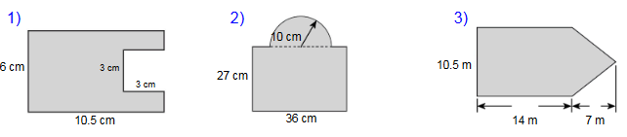
Try these on the LHS of your INB

Slide 10
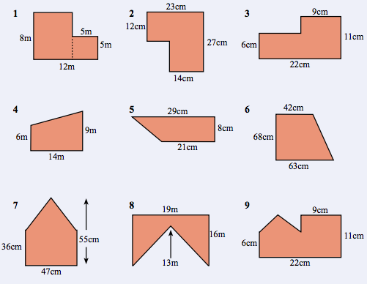
Exercise 17.4 on
page 232 of Dwyer

